Slide 1
Which gives you more energy: starting big projects or finishing up all the details? Why?

Slide 2
Lecture 1:
Fundamentals of managing projects and teams

Slide 3

Would you rather be a project manager or a team member?
ⓘ Start presenting to display the poll results on this slide.

Slide 4
Key topics covered in this lecture

Slide 5
What we will cover in this lecture
How software projects were managed in the past.
Understanding the terms project and teams
Soft skills
Mentoring
Managing a project
Leadership challenges in global project environments.

Slide 6
Prelude to managing project and teams

Slide 7
Key Terms
Project-A project is a temporary endeavour to offer and create a unique product or service.
Project Management- is the process of planning, organizing, directing, and controlling resources (such as human, financial, and technological) to achieve specific goals or objectives in an efficient and effective manner.
Notes:
Team members. The people who work with the project manager directly or indirectly to accomplish project goals and complete project activities. Project Manager- The person who manages a specific project who is expected to meet the approved objectives of the project including the project scope budget and schedule.

Slide 8
Key roles in organising projects
There are five primary project roles required to effectively manage a project.
The steering group- also called project board. Represents senior management of the organisation investing in the project.
The sponsor-is the individual for whom the project is undertaken and is the primary risk taker. The sponsor owns the business case.
The project manager-is the individual responsible with the day to day responsibility and authority for delivering the project in line with objectives and is accountable to the sponsor.
Project team member
User/Senior user-Intended users of the project output(s)
Notes:
The sponsor owns the business case which justifies investment in the project
The responsibility of the sponsor is to ensure that the project remains a viable proposition and that benefits are realised.
Project manager owns the project management plan
Users define user acceptance criteria.
The team member is allocated work to do in the project.

Slide 9
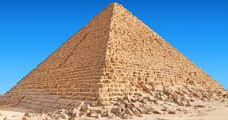
Some early projects
Great Pyramid of Giza
(Gangs of 2000- project teams)
Deadline was given as 20 years
Cost estimated at £3.93billion
10 Year time frame to dig.
Project planning and stock control was tight
Employed engineers, labourers and seasonal workers

Slide 10
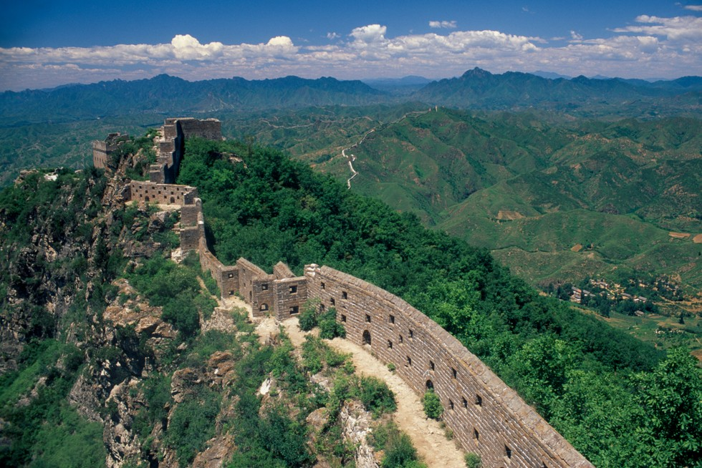
Some early projects
Great Wall of China
Estimated to cost £300bn
Labour force included soldiers, forcibly
recruited peasants, convicts, war prisoners.
Other examples include St Pauls Cathedral (1666)- Raised £1.6bn from taxes (1668), took 9 years to clear the ground (1675) and recruit project team.
1697-went through 5 general stages of design. Completed in 1708.

Slide 11
Current Projects
https://insidegovuk.blog.gov.uk/2023/09/20/undertaking-gov-uks-largest-software-infrastructure-project/
Other examples (Discussions)

Slide 12
Commonalities in early projects
Projects
People management
Time management
Materials management

Slide 13
Four (Five) periods of project management
Prior to 1958- Evolution of technology shortened project schedule. automobiles allowed effective resource allocation and mobility, whilst the telecommunication system increased the speed of communication. Gantt chart (1917), algorithm for scheduling CPM (Critical Path Method) 1957.
1958-1979 (Application of Management Science): characterised by the rapid development of computer technology. PERT. Xerox copier. Microsoft founded in 1975. Apollo in 1960. Pollaris missile in 1961.
1980-1994: Production Centre Human Resources. Introduction of PCs low cost multitasking PCs that had high efficiency in managing and controlling complex project schedules. England France Channel project, 1989 to1991. Space Shuttle Challenger project, 1983 to 1986. The disaster of the Challenger space shuttle focused attention on risk management, group dynamics, and quality management.
1995-Present?. Creating a New Environment. Dominated by internet. Year 2000 (Y2K) project successes.
Application of AI and Machine Learning in project management

Slide 14
Importance of managing projects and teams
Plan and manage strategic initiatives that generate revenue
Manage time, control expenses, ensure quality
Optimizing resource utilisation
Competitive advantage and customer satisfaction
Risk management
Team alignment and leadership
Conflict resolution
Communication and Collaboration

Slide 15
Project Manager Actions
The project manager must perform several actions throughout the duration of a project:
Prevent, anticipate, overcome
Have good planning and communication
Be responsible
Delegate

Slide 16
What to expect from a project manager
Managers who care and give constructive feedback
Managers who help team members navigate difficult situations
Managers who help you to understand what is important to focus on and enable you to have that focus
You can ask for:
One-on-One meetings
Training and Career Growth
Feedback and Workplace guidance
Mentor

Slide 17
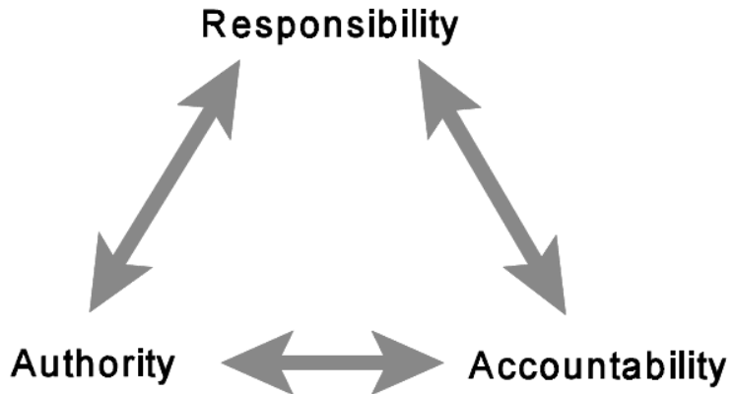
Balance in relationships
Mantaining balance in relationships: (Richman, 2002).
Notes:
Responsibility is an agreement between two or more people for the purpose of achieving a desired result.
Accountability is a consequence of assigned responsibility.
Authority is the power given to a person to complete the assigned responsibility.
Project managers must maintain good balance in assigning responsibility, delegating authority, and holding people accountable.

Slide 18
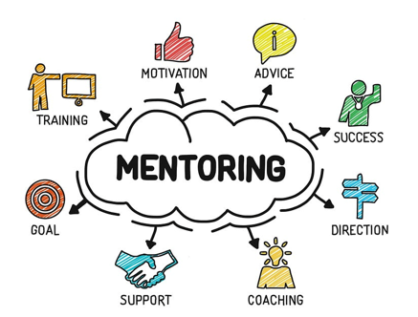
Mentoring
Notes:
Its an unofficial stage in management.
Mentoring is a good opportunity to learn to manage in a fairly safe way.
No one gets fired for being a bad mentor.
Mentoring an intern is a more formal way of managing
Make sure to identify a project for your mentee in the introductory meeting
Devise action plan

Slide 19
Traits of a Good Manager
Effective Communication
Leads by example
Demonstrates empathy, understands and values the concerns and needs of team members.
Delegates tasks effectively, trusts team members, and empowers them to take ownership of their responsibilities.
Handles conflicts professionally, seeks resolutions
Adapts to changes and challenges, embraces innovation

Slide 20
Traits of a Bad Manager
Poor communication skills, fails to provide clear instructions.
Lacks empathy, may not consider the well-being of team members
What you measure, you can improve. Typically bad managers do not give expected measurable outcomes.
Micromanages, doesn't trust the team, and fails to delegate
Reactive management styles
Alpha geeks usually are terrible managers, unless they can learn
The Process Czar-there is one true process that, if implemented correctly and followed as designed, will solve all of the team’s biggest issues.

Slide 21
Discussion
Do you feel that you can tell your manager when you have a major life event? Do you feel that your manager knows something about you personally?
Has your manager delivered good feedback to you? Bad feedback? Any feedback at all?
Has your manager helped you set any work-related goals for this year

Slide 22
Management classifications
Reactive | Proactive
Fire fighting | Planning and control
Manages by instinct | Manages by information
Speaks in generalisations | Use precision (charts/graphs)
Not seeing the picture | Sees the bigger picture
Sees planning as a waste | Plans early with contingency

Slide 23
Management styles
Autocratic management
Democratic management
Charismatic management
Bureaucratic management
Collaborative management
Laissez-faire management
Notes:
Democratic management involves decision-making through the input of the team members.
Charismatic leaders use their personal charm and appeal to inspire and influence their teams.
Bureaucratic leaders follow established rules and procedures.
Collaborative leaders prioritize teamwork and seek input from various team members.
Laissez-faire leaders provide their team members with significant autonomy and decision-making authority.
Servant leaders prioritize the well-being and development of their team members. They focus on serving others and facilitating their growth. This style fosters a positive organizational culture.
Results-oriented leaders focus on achieving specific outcomes and are less concerned with the specific methods used to achieve them.

Slide 24

Management style choice
Which of the following do you consider as the best management style?
ⓘ Start presenting to display the poll results on this slide.

Slide 25
Group Discussions
How could you benefit from using more project management principles?
ⓘ Start presenting to display the poll results on this slide.

Slide 26
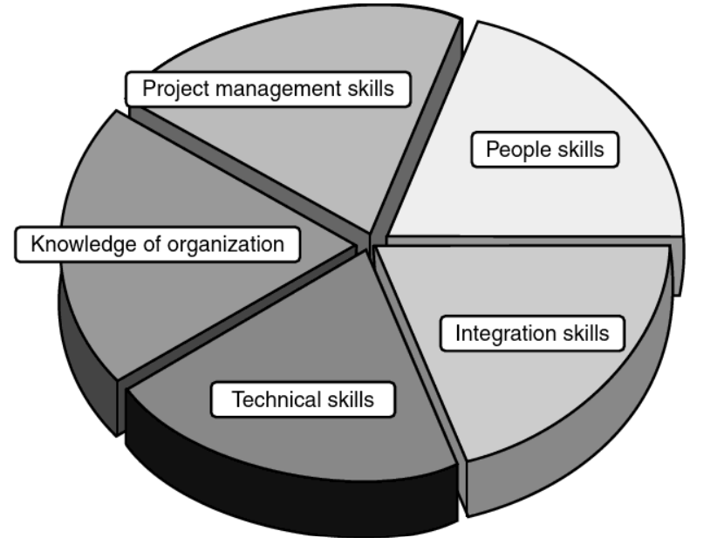
Basic Project Manager Skills

Slide 27
Functional Work versus Project Work
 | Functional Work | Project Work
Type | Repeated/On-going | Temporary/Changes
Focus | Operations
Management responsibility | Managing people | Managing process
Budgets | On-going | Specific
Risk | Stable and less risky | High risky
Visibility | Little if standards are not met | Obvious when objectives are not met
Authority | Functional manager | Project manager
Notes:
Project work and functional work are different.
Project managers can be found within Functional teams and once projects are over the teams are disbanded back into the functional organisation.
A mix of functional and project organisation structure is called the matrix organisation

Slide 28
Group Discussions
How could you benefit from using more project management principles?
Why is project management a sound strategy in todays business world?

Slide 29
Managing a project
Break down the work use Work Breakdown Structures (WBS)
Push through the details and unknowns
Run the project and adjust the plan as you go
Use the insights gained in the planning phase to manage requirements changes
Revisit the details as you get to completion.

Slide 30
Managing people
Build trust and rapport
Encourage participation by updating the new team members
Communicate your expectations
Give/Get feedback from your new team members
Create a 30/60/90 day plan

Slide 31
Challenges of leading projects in global environments
Cultural Diversity
Communication Barriers
Time Zone Differences
Legal and Regulatory compliance
Team Motivation and Engagement
Conflict resolution
Cross-Cultural Leadership
Technology integration
Logistical Complexities

Slide 32
Summary

Slide 33


Audience Q&A Session
ⓘ Start presenting to display the audience questions on this slide.

Slide 34
Key takeaway points
Managing projects and teams has been in existence for a long time
Managing project teams requires soft skills
Different management styles can be adopted by managers
Mentoring is a good beginning phase for managing
Regular One-on-One are like oil changes; if you skip them, plan to get stranded on the side of the highway at the worst possible time. (Hedlund)

Slide 35
Next lesson
Team developments and Team dynamics

Slide 36

Can you rate today's session
ⓘ Start presenting to display the poll results on this slide.

Slide 37
References
Seymour, T. and Hussein, S., 2014. The history of project management. International Journal of Management & Information Systems (IJMIS), 18(4), pp.233-240.
Richman, L. (2002). Project Management Step-by-Step, AMACOM, 2002. ProQuest Ebook
Camille, F. (2017). The manager's path: a guide for tech leaders navigating growth and change. O'Reilly Media.

Slide 38
Thank You

